Slide 1


Course Title –NATURAL LANGUAGE PROCESSING
Topic Title: NATURAL LANGUAGE PROCESSING
Presenter’s Name – B. Lakshmi Prasanna
Presenter’s ID – IARE10706 Department Name – IT
1

Slide 2
Introduction
Natural Language Processing (NLP) is a field that combines computer
science, artificial intelligence and language studies.
It helps computers understand, process and create human language in a way
that makes sense and is useful.
With the growing amount of text data from social media, websites and other sources, NLP is becoming a key tool to gain insights and automate tasks like analyzing text or translating languages..

Slide 3
Introduction
NLP is used by many applications that use language, such as text
translation, voice recognition, text summarization and chatbots.
You may have used some of these applications yourself, such as voice-operated GPS systems, digital assistants, speech-to-text software and customer service bots.
NLP also helps businesses improve their efficiency, productivity and performance by simplifying complex tasks that involve language.

Slide 4
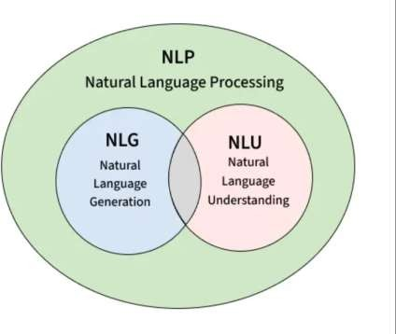
Introduction

Slide 5
Applications or Use cases of NLP
1. Chatbots:
Chatbots are a form of artificial intelligence that are programmed to interact
with humans in such a way that they sound like humans themselves.
Depending on the complexity of the chatbots, they can either just respond to specific keywords or they can even hold full conversations that make it tough to distinguish them from humans.

Slide 6
Applications or Use cases of NLP
2. Autocomplete in Search Engines
Have you noticed that search engines tend to guess what you are typing and automatically complete your sentences? For example, On typing “game” in Google, you may get further suggestions for “game of thrones”, “game of life” or if you are interested in maths then “game theory”.
All these suggestions are provided using autocomplete that uses Natural Language Processing to guess what you want to ask.

Slide 7
Applications or Use cases of NLP
3. Voice Assistants
These days voice assistants are all the rage! Whether its Siri, Alexa, or Google Assistant, almost everyone uses one of these to make calls, place reminders, schedule meetings, set alarms, surf the internet, etc.
These voice assistants have made life much easier. But how do they work? They use a complex combination of speech recognition, natural language understanding, and natural language processing to understand what humans are saying and then act on it.

Slide 8
Applications or Use cases of NLP
4. Language Translator
Want to translate a text from English to Hindi but don’t know Hindi? Well, Google Translate is the tool for you! While it’s not exactly 100% accurate, it is still a great tool to convert text from one language to another.
Google Translate and other translation tools as well as use Sequence to
sequence modeling that is a technique in Natural Language Processing.

Slide 9
Applications or Use cases of NLP
5. Sentiment Analysis
Almost all the world is on social media these days! And companies can use sentiment analysis to understand how a particular type of user feels about a particular topic, product, etc.
They can use natural language processing, computational linguistics, text analysis, etc. to understand the general sentiment of the users for their products and services and find out if the sentiment is good, bad, or neutral.

Slide 10
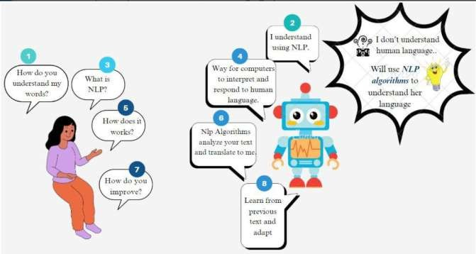
Applications or Use cases of NLP

Slide 11
Components of NLP
There are the following two components of NLP –
Natural Language Understanding (NLU)
Natural Language Understanding (NLU) helps the machine to understand and analyse human language by extracting the metadata from content such as concepts, entities, keywords, emotion, relations, and semantic roles.
NLU mainly used in Business applications to understand the customer’s problem in both spoken and written language.

Slide 12
Components of NLP
NLU involves the following tasks –
  It is used to map the given input into useful representation.
  It is used to analyze different aspects of the language.
Natural Language Generation (NLG)
Natural Language Generation (NLG) acts as a translator that converts the computerized data into natural language representation. It mainly involves Text planning, Sentence planning, and Text Realization.

Slide 13
Components of NLP
Difference between NLU and NLG:
NLU | NLG
NLU is the process of reading and interpreting language. | NLG is the process of writing or generating language.
It produces non-linguistic outputs from natural language inputs. | It produces constructing natural language outputs from non-linguistic inputs.

Slide 14
Steps in NLP
1. Lexical and Morphological Analysis
Lexical Analysis
It focuses on identifying and processing words (or lexemes) in a text. It breaks down the input text into individual tokens that are meaningful units of language such as words or phrases.
Key tasks in Lexical analysis:

Slide 15
Steps in NLP
Tokenization: Process of dividing a text into smaller chunks called tokens. For example the sentence "I love programming" would be tokenized into ["I", "love", "programming"].
Part-of-Speech Tagging: Assigning parts of speech such as noun, verb, adjective to each token in the sentence. This helps us to understand grammatical roles of words in the context.

Slide 16
Steps in NLP
Example: Consider the sentence: "I am reading a book."
Tokenization: Sentence is broken down into individual tokens or words:
["I", "am", "reading", "a", "book"]
Part-of-Speech Tagging: Each token is assigned a part of speech: ["I" → Pronoun (PRP), "am" → Verb (VBP), "reading" → Verb (VBG), "a" → Article (DT), "book" → Noun (NN)]

Slide 17
Steps in NLP
Importance of Lexical Analysis
Word Identification: It breaks text into tokens which helps the system to
understand individual words for further processing.
Text Simplification: It simplifies text through tokenization and stemming
which improves accuracy in NLP tasks.

Slide 18
Steps in NLP
Morphological Analysis
It deals with morphemes which are the smallest units of meaning in a word. It is important for understanding structure of words and their parts by identifying free morphemes (independent words like "cat") and bound morphemes (like prefixes or suffixes e.g. "un-" or "-ing").

Slide 19
Steps in NLP
Key tasks in morphological analysis:
Stemming: Reducing words to their root form like "running" to "run".
Lemmatization: Converting words to their base or dictionary form considering the context like "better" becomes "good".
Importance of Morphological Analysis
Understanding Word Structure: It helps in breaking the composition of complex words.
Improving Accuracy: It enhances accuracy of tasks such as part-of-speech tagging, syntactic parsing and machine translation.

Slide 20
Steps in NLP
2. Syntactic Analysis (Parsing)
Syntactic Analysis helps in understanding how words in a sentence are arranged according to grammar rules. It ensures that the sentence follows correct grammar which makes the meaning clearer. The goal is to create a parse tree which is a diagram showing the structure of sentence.
It breaks the sentence into parts like the subject, verb and object and shows how these parts are connected. This helps machines understand the relationships between words in the sentence.

Slide 21
Steps in NLP
Key components of syntactic analysis include:
POS Tagging: Assigning parts of speech (noun, verb, adjective) to words in
a sentence as discussed earlier.
Ambiguity Resolution: Handling words that have multiple meanings (e.g
"book" can be a noun or a verb).
Examples
Consider the following sentences:
Correct Syntax: "John eats an apple."
Incorrect Syntax: "Apple eats John an."

Slide 22
Steps in NLP
3. Semantic Analysis
Semantic Analysis focuses on understanding meaning behind words and sentences. It ensures that the text is not only grammatically correct but also logically coherent and contextually relevant.
It aims to understand dictionary definitions of words and their usage in context and also find whether the arrangement of words in a sentence makes logical sense.

Slide 23
Steps in NLP
Key Tasks in Semantic Analysis
Named Entity Recognition (NER): It identifies and classifies entities such as names of people, locations, organizations, dates and more. These entities provide important meaning in the text and help in understanding the context. For example in the sentence "Tesla announced its new electric vehicle in California," NER would identify "Tesla" as an organization and "California" as a location.

Slide 24
Steps in NLP
Word Sense Disambiguation (WSD): Many words have multiple meanings depending on the context in which they are used. It identifies the correct meaning of a word based on its surrounding text. For example word "bank" can refer to a financial institution or the side of a river. It uses context to identify which meaning applies in a given sentence which ensures that interpretation is accurate.

Slide 25
Steps in NLP
4. Discourse Integration
It is the process of understanding how individual sentences or segments of text connect and relate to each other within a broader context. This phase ensures that the meaning of a text is consistent and coherent across multiple sentences or paragraphs. It is important for understanding long or complex texts where meaning focuses on previous statements.

Slide 26
Steps in NLP
Key aspects of discourse integration:
Anaphora Resolution: Anaphora refers to the use of pronouns or other references that depend on earlier parts of the text. For example in the sentence "Taylor went to the store. She bought groceries" pronoun "She" refers back to "Taylor." It ensures that references like these are correctly understood by linking them to their antecedents.
Contextual References: Many words or phrases can only be fully understood when considered in the context of following sentences. It helps in interpreting how certain words or phrases focuses on context. For example "It was a great day" is clearer when you know what event or situation is being discussed.

Slide 27
Steps in NLP
5. Pragmatic Analysis
Pragmatic analysis helps in understanding the deeper meaning behind words and sentences by looking beyond their literal meanings. While semantic analysis looks at the direct meaning it considers the speaker's or writer's intentions, tone and context of the communication.
Key tasks in pragmatic analysis:
Figurative Meaning: Language often uses idioms or metaphors that can’t be
taken literally.

Slide 28
Steps in NLP
Understanding Intentions: Sometimes language doesn’t mean what it says literally. For example when someone asks "Can you pass the salt?" it's not about ability but a polite request. It helps to understand true intention behind such expressions.
"Hello! What time is it?" here it might be a straightforward request for the current time but it could also imply concern about being late.

Slide 29
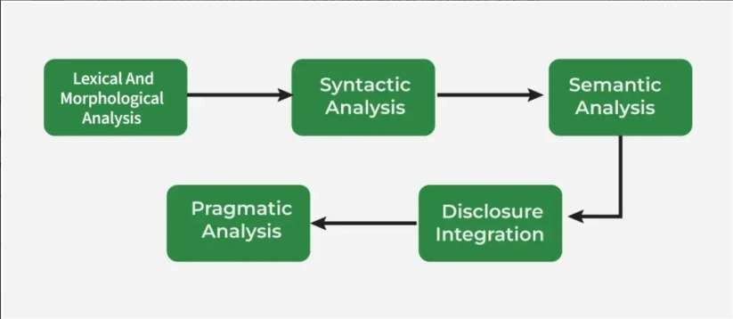
Steps in NLP

Slide 30
Finding the Structure of Words: Words and Their Components.
Words are defined in most languages as the smallest linguistic units that can
form acomplete utterance by themselves.
The minimal parts of words that deliver aspects of meaning to them are called morphemes.
Tokens: Suppose, for a moment, that words in English are delimited only by whitespace and punctuation (the marks, such as full stop, comma, and brackets)
Example: Will you read the newspaper? Will you read it? I won’t read it. If we confront our assumption with insights from syntax, we notice twowords here: words newspaper and won’t

Slide 31
Finding the Structure of Words: Words and Their Components.
Being a compound word, newspaper has an interesting derivational structure. In writing, newspaper and the associated concept is distinguished from the isolated news and paper.
The structure of won’t could be parsed as will followed by not.
In English, this kind of tokenization and normalization may apply to just a limited set of cases, but in other languages, these phenomena have to be treated different way

Slide 32

Lexemes
By the term word, we often denote not just the one linguistic form in the given context but also the concept behind the form and the set of alternative forms that can express it.
Such sets are called lexemes or lexical items, and they constitute the
lexicon of a language.
Lexemes can be divided by their behaviour into the lexical categories of verbs, nouns, adjectives, conjunctions or other parts of speech. The citation form of a lexeme, by which it is commonly identified, is also called its lemma.

Slide 33
Lexemes
When we convert a word into its other forms, such as turning the singular mouse into the plural mice or mouses, we say we inflect the lexeme.
Example: Did you see him? I didn’t see him. I didn’t see anyone Example presents the problem of tokenization of didn’t and the investigation of the internal structure of anyone. The difficulty with the definition of what counts as a word need not pose a problem for the syntactic description if we understand no one as two closely connected tokens treated as one fixed element

Slide 34
Morphemes & Morphology
These components are usually called segments or morphs.
Morphology:
Morphology is the domain of linguistics that analyses the internal structure of words.
Morphological analysis – exploring the structure of words
Words are built up of minimal meaningful elements called morphemes: played = play-ed cats = cat-s unfriendly = un-friend-ly

Slide 35
ProblemsMorphological Processing
Inflectional morphology: inflected forms are constructed from base
forms and inflectional Affixes.
Inflection relates different forms of the same word Lemma Singular Plural
Cat cat Cats
Mouse mouse mice

Slide 36
ProblemsMorphological Processing
Derivational morphology: words are constructed from roots (or
stems) and derivational affixes:
inter+national = international
international+ize = internationalize
internationalize+ation = internationalization
The simplest morphological process concatenates morphs one by one, as in disagreement-s, where agree is a free lexical morpheme and the other elements are bound grammatical morphemes contributing some partial meaning to the whole word.

Slide 37
Typology
Typology divides languages into groups by characterizing the
prevalent morphological phenomena in those languages.
It can consider various criteria, and during the history of linguistics, different classifications have been proposed.
Let us outline the typology that is based on quantitative relations
between words, their morphemes, and their features

Slide 38
Typology
Isolating, or analytic, languages include no or relatively few words that would comprise more than one morpheme (typical members are Chinese, Vietnamese, and Thai; analytic tendencies are also found in English).
Synthetic languages can combine more morphemes in one word and
are further divided into agglutinative and fusional languages.
Agglutinative languages have morphemes associated with only a single function at a time (as in Korean, Japanese, Finnish, and Tamil, etc.)

Slide 39
Typology
Fusional languages are defined by their feature-per-morpheme ratio
higher than one (as in Arabic, Czech, Latin, Sanskrit, German, etc.).
In accordance with the notions about word formation processes mentioned earlier, we can also find out using concatenative and nonlinear:
Concatenative languages linking morphs and morphemes one after another

Slide 40
Morphological Typology
Morphological typology is a way of classifying the languages of the world
that groups languages according to their common morphological structures.
The field organizes languages on the basis of how those languages form words by combining morphemes.
The morphological typology classifies languages into two broad classes like
synthetic languages and analytical languages.
The synthetic class is then further sub classified as either agglutinative
languages or fusional languages.

Slide 41
Morphological Typology
Analytic languages contain very little inflection, instead relying on features
like word order and auxiliary words to convey meaning.
Synthetic languages, ones that are not analytic, are divided into two categories: agglutinative and fusional languages.
Agglutinative languages rely primarily on discrete particles(prefixes, suffixes, and infixes) for inflection, ex: inter+national = international, international+ize = internationalize.

Slide 42
Thank You

Slide 43
Course Title –NATURAL LANGUAGE PROCESSING
Topic Title: REGULAR EXPRESSIONS, TEXT
NORMALIZATION
Presenter’s Name – B. Lakshmi Prasanna
Presenter’s ID – IARE10706 Department Name – IT
1

Slide 44
COURSE OVERVIEW:
This course is a study of computing systems that can process,
understand, or communicate in human language.
The primary focus of the course will be on understanding various NLP tasks and algorithms for effectively solving these problems, and methods for evaluating their performance.
This course is intended as a theoretical and methodological introduction to the most widely used and effective current techniques, strategies and toolkits for natural language processing, with a primary focus on those available in the Python programming language.

Slide 45
COURSES OBJECTIVES:
The students will try to learn
I. Natural language Processing for analyzing words based on
Morphology and CORPUS.
II. Probability theory with Linguistic essentials such as syntactic and
semantic analysis of text.
III. The applications of statistical learning methods and cutting-edge research models from deep learning.

Slide 46
III. COURSE OUTCOMES
At the end of the course students should be able to
CO1 Remember the knowledge of complex language behavior in
terms of phonetics, morphology
CO2 Understand the semantics and pragmatics for text processing.
CO3 Apply the CORPUS linguistics to compile and analyze the texts based on digestive games.

Slide 47
CO4 Understand various statistical approaches to machine
translation for a given natural language.
CO5 Apply Part-of-speech (POS) tagging for a given natural language and suitable modeling technique based on the structure
CO6 The art algorithms and techniques for text-based processing of
natural language with respect to morphology

Slide 48
MODULE II: REGULAR EXPRESSIONS, TEXT NORMALIZATION
Regular Expressions, patterns, words, Corpora, Text normalization, Minimum edit distance, Regular Language and FSAs, Raw Text Extraction and Tokenization, Extracting Terms from Tokens, Normalization.

Slide 49
Regular Expressions
A regular expression (regex) is a sequence of characters that defines a search pattern. It is mainly used for pattern matching in strings, such as finding, replacing, or validating text. Regex is supported in almost every programming language, including Python, Java, C++ and JavaScript.
Below image shows an example of a regular expression and explains its parts, helping you understand how filenames or patterns can be matched effectively.

Slide 50
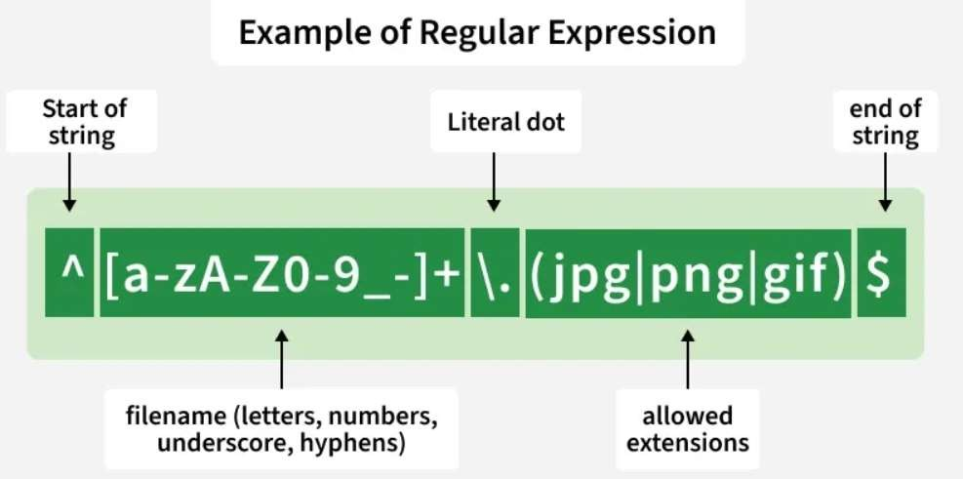

Slide 51
Importance of Regular Expression
Efficient Pattern Matching: Quickly search for specific patterns in text or data without manual checking.
Data Validation: Validate inputs like email addresses, phone numbers, URLs, and passwords.
Text Manipulation: Perform search-and-replace operations across files or
datasets effectively.
Automation in Analytics and Tools: Used in tools like Google Analytics for URL matching and filtering.
Cross-Platform Support: Works across programming languages and editors such as Python, Java, Sublime Text, and Notepad++.

Slide 52
Common Elements Used in Regular Expressions
Repeaters ( *, +, and { } ): Repeaters specify how many times the preceding character or group should appear.
Asterisk symbol (*): Matches the preceding character 0 or more times.
The Plus symbol (+): Matches the preceding character 1 or more
times.
The curly braces { … }: Defines an exact or range of repetitions.
Wildcard (.): Matches any single character except a newline.

Slide 53
Optional character (?): Matches 0 or 1 occurrence of the
preceding character.
The caret ( ^ ) symbol: Ensures the match starts at the beginning of the string.
The dollar ( $ ) symbol: Ensures the match ends at the end of the
string.

Slide 54
Patterns

Slide 55
Types of NLP patterns
Lexical Analysis: It focuses on identifying and processing words (or lexemes) in a text. It breaks down the input text into individual tokens that are meaningful units of language such as words or phrases.
Key tasks in Lexical analysis:
Tokenization: Process of dividing a text into smaller chunks called tokens. For example the sentence "I love programming" would be tokenized into ["I", "love", "programming"].
Part-of-Speech Tagging: Assigning parts of speech such as noun, verb, adjective to each token in the sentence. This helps us to understand grammatical roles of words in the context.

Slide 56
Morphological Analysis:
It deals with morphemes which are the smallest units of meaning in a word. It is important for understanding structure of words and their parts by identifying free morphemes (independent words like "cat") and bound morphemes (like prefixes or suffixes e.g. "un-" or "-ing").
Key tasks in morphological analysis:
Stemming: Reducing words to their root form like "running" to "run". Lemmatization: Converting words to their base or dictionary form considering the
context like "better" becomes "good".

Slide 57
Syntactic Analysis (Parsing):
Syntactic Analysis helps in understanding how words in a sentence are arranged according to grammar rules. It ensures that the sentence follows correct grammar which makes the meaning clearer. The goal is to create a parse tree which is a diagram showing the structure of sentence.
It breaks the sentence into parts like the subject, verb and object and shows how these parts are connected. This helps machines understand the relationships between words in the sentence.

Slide 58
Semantic Analysis
It focuses on understanding meaning behind words and sentences. It ensures that the text is not only grammatically correct but also logically coherent and contextually relevant. It aims to understand dictionary definitions of words and their usage in context and also find whether the arrangement of words in a sentence makes logical sense.

Slide 59
Discourse Integration
It is the process of understanding how individual sentences or segments of text connect and relate to each other within a broader context. This phase ensures that the meaning of a text is consistent and coherent across multiple sentences or paragraphs.
It is important for understanding long or complex texts where meaning focuses on previous statements.

Slide 60
Pragmatic Analysis
Pragmatic analysis helps in understanding the deeper meaning behind words and sentences by looking beyond their literal meanings. While semantic analysis looks at the direct meaning it considers the speaker's or writer's intentions, tone and context of the communication.

Slide 61
words
Words are the fundamental units of text, processed through steps
like tokenization (splitting into words)
and preprocessing (lowercasing, removing stopwords) to be understood numerically via techniques like Bag of Words, Word Embeddings (Word2Vec, GloVe), and advanced models like BERT, enabling tasks such as sentiment analysis, translation, and named entity recognition by capturing meaning, context, and relationships

Slide 62
Corpora
A corpus is a collection of authentic text or audio organized into datasets. Authentic here means text written or audio spoken by a native of the language or dialect. A corpus can be made up of everything from newspapers, novels, recipes, radio broadcasts to television shows, movies, and tweets. In natural language processing, a corpus contains text and speech data that can be used to train AI and machine learning systems. If a user has a specific problem or objective they want to address, they’ll need a collection of data that supports, or at least is a representation of, what they’re looking to achieve with machine learning and NLP.

Slide 63
Text normalization
Text normalization is a very important and integral step in Natural Language processing. It is used in speech recognition, text-to-speech, spam email identification, and many other applications of NLP. Consider the words: "collection", "collective","collect", and "collectively".These words are different forms of the base word "collect".
We take the base form of a word and use it in its random states. It is important to remove this randomness for our computers as they are not as good as us at handling this. Text normalization is applied to raw text to reduce this randomness.

Slide 64
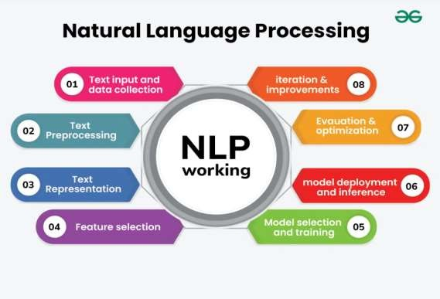

Slide 65
Minimum edit distance

Slide 66
Regular Language
Regular languages are the class of languages that can be represented using finite automata, regular expressions, or regular grammar. These languages have predictable patterns and are computationally efficient to recognize.
Properties of Regular Languages
1. Closure Properties
Regular languages are closed under operations like union,
concatenation, and Kleene star.

Slide 67
2. Finite Automata:
Every regular language can be recognized by a finite automaton (DFA or
NFA).
3. Decision Problems:
Problems like membership testing, emptiness, and equivalence can be
solved for regular languages.

Slide 68
FSA(Finite State Automata)
Finite state automata (deterministic and non-deterministic finite automata) provide decisions regarding the acceptance and rejection of a string while transducers provide some output for a given input. Thus the two machines are quite useful in language processing tasks. Finite state automata are useful in deciding whether a given word belongs to a particular language or not.

Slide 69
Raw Text Extraction and Tokenization
Text extraction refer to extracting the raw textual content from input data by removing irrelevant information like formatting, metadata and other non-text elements. The goal is to convert the text into the required encoding for natural language processing. The exact process depends on the formats of the available data within an organization, such as static data from PDFs, HTML pages or plain text files, or a continuous stream of data.

Slide 70
Tokenization is a fundamental step in Natural Language Processing (NLP). It involves dividing a Textual input into smaller units known as tokens. These tokens can be in the form of words, characters, sub-words, or sentences. It helps in improving interpretability of text by different models
Tokens: Words or Sub-words in the context of natural language processing. Example: A word is a token in a sentence, A character is a token in a word, etc.

Slide 71
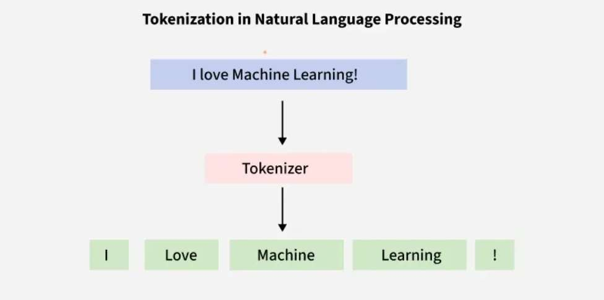

Slide 72
Extracting Terms from Tokens
Extracting terms from tokens in NLP means identifying meaningful words or phrases (terms) after breaking text into smaller units (tokens) using methods like space splitting or advanced tokenizers (e.g., spaCy) and then applying techniques such as Keyword Extraction (TextRank, TF-IDF) or Named Entity Recognition (NER) to find important concepts, entities, or keywords for analysis, sentiment, or information retrieval

Slide 73
Normalization
Normalization in NLP is basically about cleaning and standardizing text so the computer doesn’t get confused by different ways of writing the same thing.
Here are some of the key NLP techniques:
1. Text Processing and Preprocessing
Tokenization: Dividing text into smaller units, such as words or sentences.
Stemming and Lemmatization: Reducing words to their base or root
forms.

Slide 74
2. Syntax and Parsing
Part-of-Speech (POS) Tagging: Assigning parts of speech to each
word in a sentence (e.g., noun, verb, adjective).
Dependency Parsing: Analyzing the grammatical structure of a
sentence to identify relationships between words.
Constituency Parsing: Breaking down a sentence into its constituent parts or phrases (e.g., noun phrases, verb phrases).

Slide 75
3. Semantic Analysis
Named Entity Recognition (NER): Identifying and classifying entities
in text, such as names of people organizations, locations, dates, etc.
Word Sense Disambiguation (WSD): Determining which meaning of
a word is used in a given context.
Coreference Resolution: Identifying when different words refer to the same entity in a text (e.g., "he" refers to "John").

Slide 76
Text Classification in NLP
  Sentiment Analysis: Determining the sentiment or emotional tone
expressed in a text (e.g., positive, negative, neutral).
  Topic Modeling: Identifying topics or themes within a large collection
of documents.
  Spam Detection: Classifying text as spam or not spam.

Slide 77
Thank You

Slide 78
Course Title –NATURAL LANGUAGE PROCESSING
Topic Title: 3 N-GRAM LANGUAGE MODELS
Presenter’s Name – B. Lakshmi Prasanna
Presenter’s ID – IARE10706
Department Name – IT
1

Slide 79
COURSE OVERVIEW:
This course is a study of computing systems that can process,
understand, or communicate in human language.
The primary focus of the course will be on understanding various NLP tasks and algorithms for effectively solving these problems, and methods for evaluating their performance.
This course is intended as a theoretical and methodological introduction to the most widely used and effective current techniques, strategies and toolkits for natural language processing, with a primary focus on those available in the Python programming language.

Slide 80
COURSES OBJECTIVES:
The students will try to learn
I. Natural language Processing for analyzing words based on
Morphology and CORPUS.
II. Probability theory with Linguistic essentials such as syntactic and
semantic analysis of text.
III. The applications of statistical learning methods and cutting-edge
research models from deep learning.

Slide 81
III. COURSE OUTCOMES
At the end of the course students should be able to
CO1 Remember the knowledge of complex language behavior in
terms of phonetics, morphology
CO2 Understand the semantics and pragmatics for text processing.
CO3 Apply the CORPUS linguistics to compile and analyze the texts
based on digestive games.

Slide 82
III. COURSE OUTCOMES
CO4 Understand various statistical approaches to machine
translation for a given natural language.
CO5 Apply Part-of-speech (POS) tagging for a given natural
language and suitable modeling technique based on the structure
CO6 The art algorithms and techniques for text-based processing of
natural language with respect to morphology

Slide 83
N-GRAM LANGUAGE MODELS
N-grams, Evaluating language models, Generalization and zeros, smoothing, kneser-Ney smoothing, huge language models and stupid back off. Perplexity’s relation to entropy.
Inflection, Derivational Morphology, Finite-State Morphological Parsing, The Lexicon and Morphotactics, Morphological Parsing with Finite State Transducers, Combining FST Lexicon and rules.

Slide 84
N-grams
N-gram is a contiguous sequence of 'N' items like words or characters from text or speech. The items can be letters, words or base pairs according to the application. The value of ’N’ determines the order of the N-gram.
They are fundamental concept used in various NLP tasks such as
language modeling, text classification, machine translation and more.

Slide 85
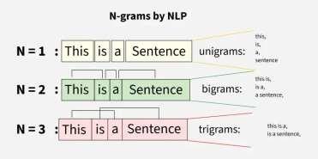
N-grams
They are of various types based on value of n:
Unigrams(Unigrams (1-grams) are single words
Bigrams (2-grams) are pairs of consecutive words
Trigrams (3-grams) are triplets of consecutive words

Slide 86
N-gram Language Model
N-gram models predict the probability of a word given the
previous n−1 words.
Example: For the phrase: “This article is on…”, if we want to predict the
likelihood of “NLP” as the next word:
p("NLP"∣"This","article","is","on")
Chain Rule of probability
Markov Assumption

Slide 87
Evaluating Language Models
Entropy: Measures the uncertainty or information content in a distribution. It
always give non negative.
H(p)=∑ p(x)⋅(−log(p(x)))
Cross-Entropy: Measures how well a probability distribution predicts a sample
from test data. Usually ≥ entropy; reflects model “surprise” at the test data.
H(p,q)=−∑ p(x)log(q(x))
Perplexity: Exponential of cross-entropy; lower values indicate a better model.
𝑁
𝑊 =
_{𝛱}𝑁
1
^{𝑖=1 𝑝 𝜔}𝑖^{ȁ𝜔}𝜄ሶ−1

Slide 88
N-grams in NLP
N-grams are used in NLP for:
Capturing Context and Semantics: N-grams help understand meaning by
looking at how words appear together
Improving Language Models: N-grams help systems predict the next word
more accurately.
Enhancing Text Prediction: N-grams suggest the next word to make typing
faster.
Information Retrieval: N-grams help search engines find and rank relevant
information.

Slide 89
Generalization and Zeros in N-grams
Generalization in the field of natural language processing (NLP) is the ability of models to efficiently make predictions on previously unseen data based on what it has learned from the training data.
Generalization is typically most closely related to two main factors, overfitting or
underfitting conditions.
The concept of zeros in NLP refers to the presence of zero-valued words in the corpus which are words that do not appear in a given input text. The presence of zeros has a significant impact on the performance of models in NLP generalization.

Slide 90
Generalization in N-grams
Ways to improve generalization in NLP:
Incorporating Inductive Biases into Model Learning:Inductive biases are assumptions that a model makes about the structure of the data it is trained on. It help a model to learn more efficiently by guiding it towards solutions that are more likely to be correct given the data it has seen so far.
Regularization:a common technique that can be used to prevent overfitting in general where the model performs well on the training data but poorly on new data.
Data Augmentation:involves generating additional training data by applying random
transformations to the existing training data.
“The dog sat on the mat” + "The cat slept in the bed”
"The dog sat on the mat, while the cat slept in the bed."

Slide 91
Generalization in N-grams
Domain Adaptation:to adapt models trained on one type of data called the source domain to a different type of data under the target domain such that model can be made more flexible and capable of performing well on a wider range of data.
Transfer Learning:involves the use of knowledge and representations learned by
a pre-trained model on one task and applying them to a different but related task.

Slide 92
Smoothing for N-grams
When working with N-grams, one of the major challenges is data sparsity especially with higher-order N-grams like 4-grams or 5-grams. As the value of N increases the number of possible N-grams grows exponentially and many of them may not appear in the training data resulting in zero probabilities for unseen sequences.
To resolve this we use Laplace Smoothing also known as Additive Smoothing. It adds a constant (typically 1) to each count ensuring that no N-gram has a zero probability even if it was not seen in the training set.
Smoothed Count = ^{count+1}
total N−grams + vocab size
This ensures that even N-grams that never appeared in the training data will
have a non-zero probability.

Slide 93
Kneser-Ney Smoothing
Kneser-Ney smoothing is one of the most sophisticated and widely used discounting techniques. It extends absolute discounting by adjusting not only the observed n-gram probabilities but also the back-off distribution.
max(𝑐 𝑤 −𝐷,0)
^{𝑃}𝐾𝑁^{(𝑤}𝑛^{ȁ 𝑤}𝑛−1 ^{, 𝑤}𝑛−2
,…)=
𝑛
c(𝑤_{𝑛−1},𝑤_{𝑛−2},… )
+λ 𝑃 (𝑤 ∣ 𝑤 ,…)
𝐾𝑁 𝑛 𝑛−1
It is a unique in that it takes into account the diversity of contexts in which a word appears. It effectively balances the probability estimates across both frequent and rare n-grams, making it particularly effective for handling rare events.

Slide 94
Stupid Back off Method in N-gram
N-gram stupid backoff is an efficient NLP technique for language modeling, especially with huge datasets like web text, that predicts word probabilities by "backing off" to shorter n-grams (e.g., from trigram to bigram, then unigram)
when a higher-order n-gram isn't found, using a simple fixed weight (like 0.4) instead of complex smoothing, making it fast and effective without normalizing probabilities.

Slide 95
Stupid Back off Method in N-gram
Check Trigram: Look for the trigram (e.g., "raining cats and") in your data.
If Found: Calculate its probability (count of trigram / count of bigram).
If Not Found (Zero Count):
  Back Off: Move to the bigram (e.g., "cats and").
  Multiply by 0.4: Multiply the bigram's probability by a fixed factor (λ = 0.4).
  If Bigram Also Not Found: Back off to the unigram (e.g., "and") and
multiply by 0.42 (or continue the process).
Unigram Base: The process stops at the unigram, which uses its simple count-
based probability (count of word / total words).

Slide 96
Inflection in NLP
In NLP, inflection is modifying words (like adding '-s', '-ed', '-ing') to show grammatical info (plural, tense, etc.) without changing the core meaning (e.g., run -> runs, ran), distinct from derivation (creating new words
like happy to happiness)
and its study (morphology) is key for tasks like search, translation, and spell-checking, often using tools like NLTK and techniques like lemmatization.

Slide 97
Derivational Morphology in NLP
Derivational morphology in NLP studies how new words are formed, changing meaning or part of speech (like happy to happiness), unlike inflectional morphology which just adds grammar (like cat to cats).
Key Concepts in NLP & Derivation:
  Derivation: Adding prefixes (un-, re-) or suffixes (-ness, -ly, -able) to change
a word's meaning or grammatical class (e.g., kind (adj) -
> unkind (adj), happy (adj) -> happiness (noun)).
  Inflection: Modifying words for tense, number, etc., without changing class
(e.g., walk -> walked, dog -> dogs).
  Morphological Analysis: The process of identifying morphemes (root + affixes) in text, crucial for tasks like Machine Translation, Information Retrieval.

Slide 98
Derivational Morphology in NLP
Stemming & Lemmatization: Algorithms (like Porter
Stemmer, Yarowsky) reduce words to their base/root form, handling derived forms.
Zero Derivation: When a word's form doesn't change but its
category does (e.g., Google (noun) -> to google (verb)).
Productivity: How easily an affix (like -ness) creates new words,
indicating its rule strength.

Slide 99
Finite-State Morphological Parsing
Finite-State Morphological Parsing in NLP uses Finite-State Transducers (FSTs) to break words into morphemes (stems, prefixes, suffixes), handling both regular and irregular forms through cascades of automata for lexicon (word parts), morphotactics (rules), and spelling changes, effectively mapping surface words to their deep structure for tasks like stemming, lemmatization, and POS tagging.

Slide 100
Finite-State Morphological Parsing
Core Concepts:
Finite-State Transducer (FST): A machine that takes an input string (like "cats") and outputs another string (like "cat"+"plural"), mapping letters to morphemes.
Morphemes: Smallest meaningful units (e.g., "run" in "running", "-ing"
as a plural marker).
Lexicon: Stores stems and affixes (prefixes/suffixes).
Morphotactics: Rules for valid morpheme combinations (e.g., verb stem
+ -ed).
Orthographic Rules: Handle spelling changes (e.g., 'y' to 'i' in "fly" ->
"flies").

Slide 101
Finite-State Morphological Parsing
How it Works:
Input: A word like "unhappily".
FST Processing: The FST reads letters, transitions through states, and maps them to output symbols (morphemes).
Output: The word is decomposed into its components: un- (prefix)
+ happy (stem) + -ly (suffix).
Irregularities: Special paths handle irregulars (e.g., goose -> geese).

Slide 102
Lexicon and Morphotactics
Lexicon is a structured list of a language's words, stems, and affixes
with associated information (like part of speech and meaning)
Morphotactics defines the rules for the allowable ordering and
combination of these morphemes to form valid words.
These two components are fundamental to morphological analysis, often implemented using Finite State Transducers (FSTs) for efficient processing of word structures.

Slide 103
Lexicon
A lexicon in NLP serves as a structured vocabulary database for a given language. Unlike a simple dictionary that might list every inflected form, an efficient NLP lexicon typically stores only the base forms (stems) and the various affixes (prefixes, suffixes). Key aspects of the lexicon:
Storage Efficiency: Storing only stems and rules for inflections significantly reduces the overall number of entries compared to listing every possible word form (e.g., storing "run" and the "-ing" morpheme instead of "running" as a separate entry).
Information Richness: Each entry in the lexicon includes crucial information, such as the part of speech (noun, verb, adjective), semantic relationships (synonyms, antonyms), and other grammatical properties.
Dynamic Use: The lexicon is used with morphological rules to derive and analyze the full range of word forms in a language, allowing systems to handle words they haven't encountered before (productivity).

Slide 104
Morphotactics in NLP
Morphotactics refers to the model or set of rules that governs how morphemes can be ordered and combined within a word. Morphemes are the smallest units of meaning in a language.
Key aspects of morphotactics:
Rule-Based Ordering: It dictates which classes of morphemes can follow others. For example, a plural morpheme like s must follow a noun stem in English (e.g., cat + -s = cats), not precede it.
Valid Word Formation: Morphotactic rules, often modeled using Finite State Automata (FSA), determine whether a sequence of morphemes constitutes a legitimate word in the language.
Integration with Orthographic Rules: Morphotactics works alongside orthographic (spelling) rules, which manage the letter changes that occur when morphemes are combined (e.g., changing city + -s to cities by replacing y with ie).

Slide 105
Thank You

Slide 106
Course Title –NATURAL LANGUAGE PROCESSING
MODULE 4 – WORD SENSE DISAMBIGUATION
Presenter’s Name – B. Lakshmi Prasanna
Presenter’s ID – IARE10706
Department Name – IT
1

Slide 107
COURSE OVERVIEW:
This course is a study of computing systems that can process,
understand, or communicate in human language.
The primary focus of the course will be on understanding various NLP tasks and algorithms for effectively solving these problems, and methods for evaluating their performance.
This course is intended as a theoretical and methodological introduction to the most widely used and effective current techniques, strategies and toolkits for natural language processing, with a primary focus on those available in the Python programming language.

Slide 108
COURSES OBJECTIVES:
The students will try to learn
I. Natural language Processing for analyzing words based on
Morphology and CORPUS.
II. Probability theory with Linguistic essentials such as syntactic and
semantic analysis of text.
III. The applications of statistical learning methods and cutting-edge
research models from deep learning.

Slide 109
III. COURSE OUTCOMES
At the end of the course students should be able to
CO1 Remember the knowledge of complex language behavior in
terms of phonetics, morphology
CO2 Understand the semantics and pragmatics for text processing.
CO3 Apply the CORPUS linguistics to compile and analyze the texts
based on digestive games.

Slide 110
CO4 Understand various statistical approaches to machine
translation for a given natural language.
CO5 Apply Part-of-speech (POS) tagging for a given natural
language and suitable modeling technique based on the structure
CO6 The art algorithms and techniques for text-based processing of
natural language with respect to morphology

Slide 111
MODULE IV: WORD SENSE DISAMBIGUATION (09)
Methodological Preliminaries, Supervised Disambiguation: Bayesian classification, An information theoretic approach, Dictionary-Based Disambiguation: Disambiguation based on sense, Thesaurus based disambiguation, Disambiguation based on translations in a second-language corpus.

Slide 112
Word Sense Disambiguation (WSD) is the process of determining which meaning of a word is intended in a particular context. It addresses the challenge of polysemy, where many words have multiple related meanings. For example, when we encounter the sentence "I went to the bank," we automatically understand whether "bank" refers to a financial institution or the edge of a river based on surrounding context clues.
WSD is important in many natural language processing (NLP) applications because if word meanings
are misidentified, the results can be problematic:

Slide 113
Word Sense Disambiguation (WSD) is the process of determining which meaning of a word is intended in a particular context. It addresses the challenge of polysemy, where many words have multiple related meanings. For example, when we encounter the sentence "I went to the bank," we automatically understand whether "bank" refers to a financial institution or the edge of a river based on surrounding context clues.
WSD is important in many natural language processing (NLP) applications
because if word meanings are misidentified, the results can be problematic:

Slide 114
Machine translation systems may produce incorrect translations due to
misinterpretation of word meanings.
Information retrieval systems might return irrelevant results because of semantic uncertainty or confusion.
Primary Approaches to Word Sense Disambiguation
WSD techniques can be categorized into three main approaches, each with distinct
methodologies and use cases.
Knowledge-Based Methods
  Knowledge-based approaches utilize lexical resources such as dictionaries and semantic networks to determine word meanings.

Slide 115
Compare context words with dictionary definitions of candidate senses
Calculate overlap between contextual words and definitional content
Select the sense with maximum overlap score
Advantages:
Does not require annotated training data
Leverages existing linguistic knowledge bases
Provides interpretable disambiguation decisions
The Lesk algorithm assumes that words used together in coherent text will have
semantic relationships reflected in their dictionary definitions.

Slide 116
Supervised Learning Methods
  Supervised approaches treat WSD as a classification problem, training machine learning models on datasets where word instances have been manually annotated with correct senses.
  Key characteristics:
  Requires substantial amounts of sense-annotated training data
  Employs standard machine learning algorithms such as support vector
machines, decision trees or neural networks
  Uses contextual features including surrounding words and syntactic
relationships

Slide 117
Training process:
Extract features from annotated examples
Train classifier to map feature vectors to sense labels
Apply trained model to disambiguate new instances
While supervised methods achieve high accuracy, they face the challenge of
obtaining sufficient annotated data for all word-sense combinations.
Unsupervised Learning Methods
  Unsupervised approaches operate without sense-labeled training data, instead
relying on distributional patterns in large text corpora.

Slide 118
Fundamental principle:
Words appearing in similar contexts tend to have similar meanings
Cluster word occurrences based on contextual similarity
Assign sense labels to resulting clusters
Bayesian classification is a supervised learning approach used in Word Sense Disambiguation (WSD) where the correct sense of a word is identified using probability theory, specifically Bayes’ Theorem.
In this method, WSD is treated as a classification problem, where each possible
sense of a word represents a class.

Slide 119
The Information-Theoretic Approach to Word Sense Disambiguation (WSD)
applies concepts from information theory such as entropy, information gain,
and mutual information to identify the correct sense of a word in a given context.
In this approach, the sense of a word is selected based on the maximum
information gained from contextual features.

Slide 120
In Natural Language Processing (NLP), word sense disambiguation (WSD) is the challenge of determining which "sense" (meaning) of a word is activated by its use in a specific context, a process that appears to be mostly unconscious in individuals.
Lesk Algorithm is a way of Word Sense Disambiguation. The Lesk algorithm is a dictionary-based approach that is considered seminal. It is founded on the idea that words used in a text are related to one another, and that this relationship can be seen in the definitions of the words and their meanings.

Slide 121
The pair of dictionary senses having the highest word overlap in their dictionary meanings are used to disambiguate two (or more) terms. Michael E. Lesk introduced the Lesk algorithm in 1986 as a classic approach for word sense disambiguation in Natural Language Processing. The Lesk algorithm assumes that words in a given "neighborhood" (a portion of text) will have a similar theme. The dictionary definition of an uncertain word is compared to the terms in its neighborhood in a simplified version of the Lesk algorithm.
Basic Lesk Algorithm implementation involves the following steps:
Count the number of words in the neighborhood of the word and in the dictionary definition of that sense for each sense of the word being disambiguated.

Slide 122
Word Sense Disambiguation (WSD) is the process of determining which meaning of a word is intended in a particular context. It addresses the challenge of polysemy, where many words have multiple related meanings.
For example, when we encounter the sentence "I went to the bank," we automatically understand whether "bank" refers to a financial institution or the
edge of a river based on surrounding context clues.

Slide 123
Thesaurus-based disambiguation is a knowledge-based approach to Word Sense Disambiguation (WSD) that uses a thesaurus or lexical knowledge base (such as WordNet) to identify the correct sense of an ambiguous word based on semantic similarity.
A thesaurus groups words into synonyms, hypernyms, hyponyms, and related
concepts, which are exploited to determine meaning from context.
Each possible sense of a word is associated with a set of related words from the
thesaurus.
Context words are compared with these related words.

Slide 124
Identify the ambiguous word and its possible senses.
Retrieve synonyms and semantically related words for each sense from the
thesaurus.
Compare these with the context words in the sentence.
Measure semantic overlap or similarity.
Choose the sense with maximum similarity.

Slide 125
Sentence:
“The mouse was connected to the computer.”
Possible senses of mouse:
Animal
Computer device
Thesaurus relations:
Computer device → keyboard, screen, monitor
Animal → rat, rodent

Slide 126
Advantages
Does not require training data
Uses rich semantic relations
Effective for general-purpose language
Limitations
Depends on quality and coverage of the thesaurus
Difficult for domain-specific terms
Limited handling of contextual nuances

Slide 127
Cross-Lingual Word Sense Disambiguation
It is closely related to a concept of Word Sense Disambiguation (WSD) is the process of determining which meaning of a word is intended in a particular context. It addresses the challenge of polysemy, where many words have multiple related meanings. For example, when we encounter the sentence "I went to the bank," we automatically understand whether "bank" refers to a financial institution or the edge of a river based on surrounding context clues.

Slide 128
WSD is important in many natural language processing (NLP) applications
because if word meanings are misidentified, the results can be problematic:
Machine translation systems may produce incorrect translations due to misinterpretation of word meanings.
Information retrieval systems might return irrelevant results because of semantic
uncertainty or confusion.
Question-answering systems require precise word meanings to provide accurate
and relevant answers.

Slide 129
Primary Approaches to Word Sense Disambiguation
WSD techniques can be categorized into three main approaches, each with
distinct methodologies and use cases.
Knowledge-Based Methods
  Knowledge-based approaches utilize lexical resources such as dictionaries and semantic networks to determine word meanings. The Lesk algorithm works over this approach.

Slide 130
Advantages:
Does not require annotated training data
Leverages existing linguistic knowledge bases
Provides interpretable disambiguation decisions
The Lesk algorithm assumes that words used together in coherent text will have
semantic relationships reflected in their dictionary definitions.

Slide 131
2. Supervised Learning Methods
Supervised approaches treat WSD as a classification problem, training machine learning models on datasets where word instances have been manually annotated with correct senses.
Training process:
Extract features from annotated examples
Train classifier to map feature vectors to sense labels
Apply trained model to disambiguate new instances

Slide 132
While supervised methods achieve high accuracy, they face the challenge of
obtaining sufficient annotated data for all word-sense combinations.
Unsupervised Learning Methods
Unsupervised approaches operate without sense-labeled training data, instead
relying on distributional patterns in large text corpora.
Fundamental principle:
  Words appearing in similar contexts tend to have similar meanings
  Cluster word occurrences based on contextual similarity
  Assign sense labels to resulting clusters

Slide 133
Implementation: Basic WSD System
1. Creating the Class and Sense Inventory
We create a BasicWSD class which stores a sense inventory for target words. Each word has multiple meanings and each sense is associated with keywords that help identify it.
self.sense_inventory: Stores each ambiguous word along with its senses and their associated keywords.
self.stop_words: Stores common words (e.g., the and, of) to be ignored during
processing.

Slide 134
2. Preprocessing the Input Sentence
We define a method to clean up the input sentence. It removes unnecessary
words and punctuation so that only meaningful context remains.
sentence.lower(): Converts all characters to lowercase for consistency.
sentence.replace(ch, ""): Removes punctuation symbols.
sentence.split(): Splits the sentence into words and filters out stop words and
single-character tokens.

Slide 135
3. Disambiguating the Target Word
We now add the method that predicts the correct sense of the target word. It
compares context words with keywords for each sense.
context = . : Extracts all context words except the target word.
scores[sense] = len(set(context) & set(keywords)): Counts how many context
words match each sense's keywords.
max(scores, key=scores.get): Selects the sense with the highest overlap score.

Slide 136
4. Testing the Implementation
We create an object of the class and test it with sample sentences.
wsd.disambiguate(word, sentence): Returns the predicted sense and the overlap scores for each possible sense.
The output displays the original sentence, the target word, predicted sense and a
breakdown of scores.

Slide 137
Challenges and Limitations
The basic approach faces several constraints:
Limited coverage: Only handles predefined words with manually curated sense inventories
Shallow semantic understanding: Simple word overlap cannot capture deeper
semantic relationships
Context dependency: Requires sufficient contextual clues for accurate
disambiguation

Slide 138
Broader WSD Challenges
Data sparsity : As many word-sense combinations appear infrequently in
training corpora, making supervised learning difficult for rare senses.
Sense granularity : Different lexical resources may define sense boundaries differently. Fine-grained sense distinctions are typically more difficult to disambiguate than coarse-grained categories.
Domain adaptation : Models trained on general text often perform poorly
when applied to specialized domains such as medical, legal or technical texts.

Slide 139
Applications and Future Directions
WSD technology finds practical application across numerous domains:
Machine Translation: Accurate sense identification improves translation quality by selecting appropriate target language equivalents for ambiguous source words.
Information Retrieval: Search engines employ WSD to better understand user query intent and retrieve more relevant documents.
Content Analysis: Text processing systems benefit from precise word meanings for tasks such as sentiment analysis, topic modeling and document classification.

Slide 140
Thank You

Slide 141
Course Title –NATURAL LANGUAGE PROCESSING
Topic Title: MARKOV MODEL AND POS TAGGING
Presenter’s Name – B. Lakshmi Prasanna
Presenter’s ID – IARE10706 Department Name – IT

Slide 142
COURSE OVERVIEW:
This course is a study of computing systems that can process,
understand, or communicate in human language.
The primary focus of the course will be on understanding various NLP tasks and algorithms for effectively solving these problems, and methods for evaluating their performance.
This course is intended as a theoretical and methodological introduction to the most widely used and effective current techniques, strategies and toolkits for natural language processing, with a primary focus on those available in the Python programming language.

Slide 143
COURSES OBJECTIVES:
The students will try to learn
I. Natural language Processing for analyzing words based on
Morphology and CORPUS.
II. Probability theory with Linguistic essentials such as syntactic and
semantic analysis of text.
III. The applications of statistical learning methods and cutting-edge research models from deep learning.

Slide 144
COURSES OUTCOMES:
At the end of the course students should be able to
CO1 Remember the knowledge of complex language behavior in
terms of phonetics, morphology
CO2 Understand the semantics and pragmatics for text processing.
CO3 Apply the CORPUS linguistics to compile and analyze the texts based on digestive games.

Slide 145
CO4 Understand various statistical approaches to machine
translation for a given natural language.
CO5 Apply Part-of-speech (POS) tagging for a given natural language and suitable modeling technique based on the structure
CO6 The art algorithms and techniques for text-based processing of natural language with respect to morphology

Slide 146
MODULE V: MARKOV MODEL AND POS TAGGING (09)
Markov Model: Hidden Markov model, Fundamentals, Probability of properties, Parameter estimation, Variants, Multiple input observation. The Information Sources in Tagging: Markov model taggers, Viterbi algorithm, Applying HMMs to POS tagging, Applications of Tagging.

Slide 147
Module Introduction – Markov Model and POS Tagging:
Markov Models are probabilistic models that are widely used in Natural Language Processing to represent sequential data such as sentences and word sequences. They help in predicting the next element in a sequence based on previous elements.
This module introduces the concept of Hidden Markov Models (HMMs), which extend basic Markov models by allowing hidden states that are not directly observable but influence observable outputs.
A major application discussed in this module is Part-of-Speech (POS) Tagging, which is the process of assigning grammatical tags like noun, verb, adjective, etc., to words in a sentence.
The module also explains the Viterbi Algorithm, which is an efficient dynamic programming approach used to find the most probable sequence of hidden states in HMMs.Overall, this module bridges probability theory and linguistic structure, making it essential for building real-world NLP systems.

Slide 148
Introduction to Markov Models
A Markov Model is a stochastic model that predicts future states based only on the current state, not on the entire history of past states. This simplifying assumption is known as the Markov property.
In the context of NLP, this means that the probability of a word or tag
occurring depends only on a limited number of previous words or tags.
Markov models are particularly useful for language tasks because language naturally follows a sequential structure.
By reducing dependency on long histories, Markov models make
probability computation feasible for large text corpora.

Slide 149
Fundamentals of Markov Models
The fundamental components of a Markov model include states, which represent possible conditions or categories, such as grammatical tags in POS tagging.
Another important component is the transition probability, which
defines the likelihood of moving from one state to another.
The initial state probability represents the likelihood of the sequence starting in a particular state.
The most important characteristic of Markov models is their
memoryless nature, which simplifies both modeling and computation.

Slide 150
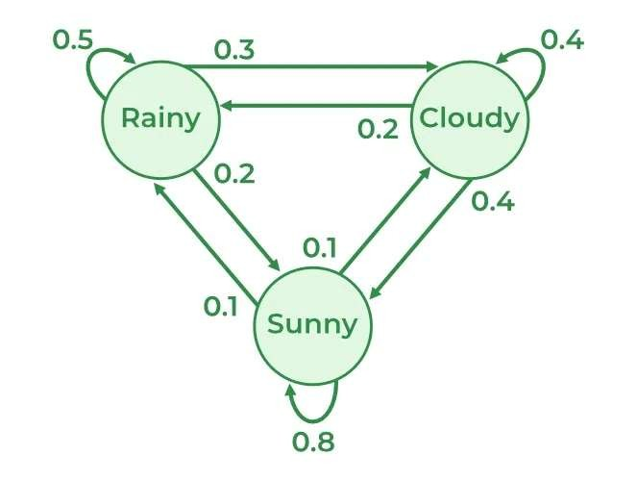

Slide 151
Types of Markov Models
In a Visible Markov Model, the states are directly observable, and
the output sequence corresponds exactly to the state sequence.
These models are useful in simple prediction problems where the system’s internal state is fully known.
In contrast, a Hidden Markov Model (HMM) has states that are not
directly visible, but each state produces observable outputs.
HMMs are highly suitable for NLP tasks because linguistic categories
like POS tags are hidden, while words are observable.

Slide 152
Hidden Markov Model (HMM) – Overview
A Hidden Markov Model is a probabilistic framework where the system transitions between hidden states while generating observable outputs.
In POS tagging, the hidden states correspond to grammatical
categories, and the observed outputs are the words in a sentence.
The goal of using an HMM is to determine the most probable sequence of hidden states given a sequence of observed words.
HMMs are widely used in NLP because they effectively combine
linguistic structure with statistical modeling.

Slide 153
Components of a Hidden Markov Model
The set of states represents all possible POS tags that can be assigned to words in a language.
The observations correspond to the words present in the input
sentence.
Transition probabilities model the likelihood of one POS tag following
another, capturing syntactic patterns of language.
Emission probabilities represent the likelihood of a word being generated from a particular POS tag.
Initial probabilities define how likely a tag is to appear at the
beginning of a sentence.

Slide 154
Probability of Properties in HMM
Transition probability measures how likely a particular tag follows
another tag, reflecting grammatical rules and language structure.
Emission probability measures how likely a word is associated with a particular tag, capturing lexical behavior.
These probabilities together allow the HMM to model both syntactic
and lexical information.
Accurate probability estimation is critical for improving the
performance of POS tagging systems.

Slide 155
Parameter Estimation in HMM
Parameter estimation refers to the process of calculating transition
and emission probabilities from training data.
The most common method used is Maximum Likelihood Estimation (MLE), which relies on frequency counts from annotated corpora.
Transition probabilities are calculated by dividing the number of times one tag follows another by the total occurrences of the previous tag.
Emission probabilities are calculated by dividing the number of times
a word appears with a tag by the total occurrences of that tag.

Slide 156
Variants of Markov Models
Unigram models assume that each word or tag is independent of
previous ones, making them simple but less accurate.
Bigram models consider the immediately preceding word or tag, offering a balance between simplicity and accuracy.
Trigram models use two previous tags, capturing richer contextual
information but requiring more training data.
Higher-order Markov models generally improve accuracy but
increase computational complexity and data requirements.

Slide 157
Multiple Input Observation in Markov Models
In real-world NLP tasks, models often need to handle multiple observations simultaneously rather than a single stream of data.
Multiple input observation refers to scenarios where the system considers more than one observable feature at each time step, such as word form, suffix, capitalization, or punctuation.
In POS tagging, this helps improve accuracy by incorporating additional
linguistic cues beyond just the word itself.
Hidden Markov Models can be extended to support multiple observations by adjusting the emission probability calculations.
This approach makes the tagging system more robust, especially when
dealing with ambiguous or unseen words.

Slide 158
Information Sources in POS Tagging
POS tagging relies on multiple information sources to assign accurate grammatical tags to words.
The lexical information source uses word-level knowledge, such as known word-tag associations from a corpus.
The contextual information source uses neighboring tags or words to
determine the most likely tag sequence.
The statistical information source uses probabilities learned from annotated training data.
Markov models efficiently combine these information sources into a unified probabilistic framework.

Slide 159
Markov Model Taggers
Markov Model Taggers are statistical POS taggers that use Markov assumptions to predict the most probable tag sequence.
These taggers assume that the probability of a tag depends only on a
limited number of previous tags.
Bigram and trigram taggers are commonly used because they
balance contextual awareness and computational efficiency.
Markov taggers outperform rule-based taggers when trained on sufficiently large annotated corpora.
They are widely used in modern NLP pipelines due to their
adaptability and accuracy.

Slide 160
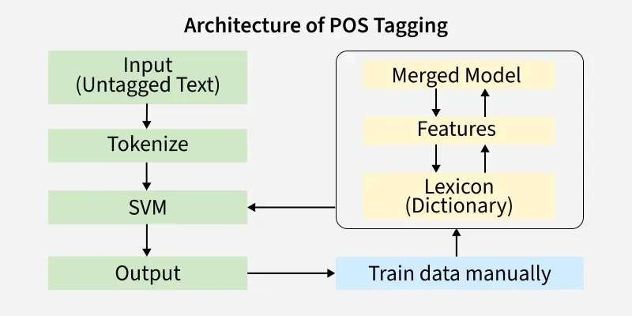

Slide 161
POS Tagging Using Hidden Markov Models
In HMM-based POS tagging, the observed sequence is the sentence, and the hidden sequence is the POS tags.
The goal is to find the tag sequence that maximizes the joint
probability of the tag sequence and the observed words.
HMMs model both syntactic patterns (through transition probabilities)
and lexical patterns (through emission probabilities).
This dual modeling capability makes HMMs highly effective for POS tagging.
HMM-based tagging is language-independent and can be adapted to
different languages with proper training data.

Slide 162
Challenges in POS Tagging
One major challenge in POS tagging is ambiguity, where a word can belong to multiple grammatical categories.
Unknown or out-of-vocabulary words pose difficulties because they
do not appear in the training corpus.
Sparse data problems occur when certain tag sequences appear
rarely, leading to unreliable probability estimates.
Noise and errors in annotated corpora can affect parameter estimation.
HMMs address these challenges partially, but smoothing techniques
are often required for better performance.

Slide 163
Working Principle of the Viterbi Algorithm
The algorithm works by constructing a trellis diagram, where rows represent states and columns represent time steps.
At each step, it computes the maximum probability of reaching a
state given the previous computations.
The algorithm keeps track of the best path leading to each state
using backpointers.
After processing the entire sentence, backtracking is used to retrieve the most probable tag sequence.
This systematic approach guarantees the optimal solution under the
Markov assumptions.

Slide 164
Steps in the Viterbi Algorithm
Initialization: Assign initial probabilities to each state for the first
observation.
Recursion: For each subsequent observation, compute the maximum probability for each state using transition and emission probabilities.
Termination: Identify the final state with the highest probability.
Backtracking: Trace back through stored paths to obtain the best
tag sequence.
These steps make the algorithm both efficient and reliable for sequence labeling tasks.
24

Slide 165
Applying Viterbi Algorithm to POS Tagging
For a given sentence, the Viterbi algorithm evaluates all possible tag transitions efficiently.
It uses transition probabilities to model grammatical structure and
emission probabilities to model word-tag associations.
The algorithm assigns the tag sequence with the highest probability
as the final output.
This method ensures global optimization rather than making local greedy decisions.
As a result, HMM + Viterbi produces more accurate tagging than
simple rule-based approaches.

Slide 166
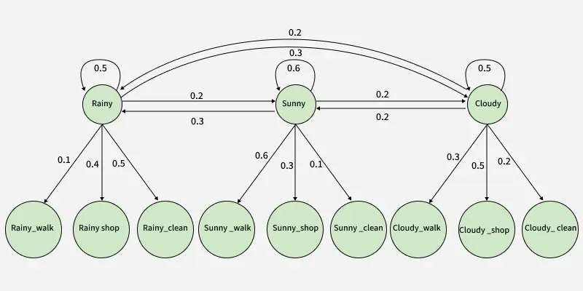

Slide 167
Advantages of HMM-Based POS Tagging
HMM-based taggers are statistically sound and based on well-defined probabilistic principles.
They can be trained automatically using annotated corpora, reducing
manual effort.
The approach is flexible and can be adapted to different languages
and domains.
Integration with the Viterbi algorithm ensures optimal tag sequence selection.
Due to these advantages, HMM-based POS tagging remains a
foundational technique in NLP.

Slide 168
Need for Advanced POS Tagging Techniques
Simple rule-based tagging systems fail when language becomes ambiguous or complex, making advanced statistical methods necessary.
As natural language contains uncertainty and variability, probabilistic
models like HMMs provide better generalization.
Advanced POS tagging techniques handle unseen words and varying sentence structures more effectively.
These techniques form the backbone of modern NLP applications
such as parsing and machine translation.

Slide 169
Ambiguity in Natural Language
Ambiguity occurs when a word can have multiple meanings or
grammatical roles depending on context.
For example, the word “book” can act as a noun or a verb.
POS tagging systems must rely on surrounding context to resolve
such ambiguities.
Markov models address ambiguity by choosing the most probable tag sequence rather than individual tags.

Slide 170
Lexical Ambiguity vs Structural Ambiguity
Lexical ambiguity arises when a single word has multiple POS tags.
Structural ambiguity occurs when a sentence can have multiple
grammatical interpretations.
POS tagging primarily addresses lexical ambiguity but also
contributes to resolving structural ambiguity.
Contextual probabilities play a key role in distinguishing between ambiguous interpretations.

Slide 171
Smoothing Techniques in HMM
Smoothing techniques are used to handle zero-probability issues
caused by unseen events.
Without smoothing, unseen tag transitions or emissions would result in zero probability for entire sequences.
Common smoothing techniques include add-one smoothing and
back-off models.
Smoothing improves model robustness and ensures better
generalization to unseen data.

Slide 172
Role of Corpus in POS Tagging
A corpus is a large, structured collection of annotated text used for
training NLP models.
POS taggers rely heavily on annotated corpora to learn word-tag associations and tag transitions.
The quality and size of the corpus directly affect tagging accuracy.
Well-known corpora include Penn Treebank and Brown Corpus.

Slide 173
Training Phase of HMM POS Tagger
During training, the HMM learns transition and emission probabilities
from the annotated corpus.
Frequency counts of tag transitions and word-tag pairs are collected.
These counts are converted into probabilities using normalization.
The trained model is then ready to tag unseen sentences.

Slide 174
Testing Phase of HMM POS Tagger
In the testing phase, the trained HMM is applied to new sentences.
The Viterbi algorithm is used to compute the most probable tag
sequence.
The system does not know the correct tags during testing.
Performance is evaluated by comparing predicted tags with reference annotations.

Slide 175
Evaluation of POS Tagging Systems
Evaluation measures how accurately the tagging system assigns
correct tags.
Accuracy is computed as the percentage of correctly tagged words.
Precision and recall may also be used for tag-specific evaluation.
Evaluation helps identify weaknesses and improve model performance.

Slide 176
Tagging Accuracy Metrics
Accuracy is defined as the ratio of correctly tagged words to total words.
Error rate measures the proportion of incorrectly assigned tags.
Confusion matrices are used to analyze tag-level performance.
These metrics provide insight into common tagging errors.

Slide 177
Error Analysis in POS Tagging
Error analysis helps understand why the system makes incorrect
predictions.
Errors may arise from ambiguity, sparse data, or incorrect probability estimates.
Analyzing errors helps refine probability models and smoothing
techniques.
This process is essential for improving real-world tagging systems.

Slide 178
Comparison with Rule-Based Tagging
Rule-based taggers rely on manually crafted linguistic rules.
While accurate for simple cases, they are difficult to scale and
maintain.
HMM-based taggers automatically learn from data and adapt to new
domains.
Statistical taggers outperform rule-based systems on large datasets.

Slide 179
Stochastic vs Deterministic Taggers
Deterministic taggers assign tags based on fixed rules.
Stochastic taggers use probabilities to choose the most likely tag.
HMM-based taggers belong to stochastic approaches.
Stochastic taggers better handle uncertainty and ambiguity in language.

Slide 180
Advantages of Markov-Based POS Tagging
Markov models provide a mathematically sound framework.
They balance efficiency and accuracy.
Models are language-independent and adaptable.
Suitable for large-scale NLP systems.

Slide 181
Limitations of HMM-Based POS Tagging
HMMs assume limited context due to the Markov assumption.
They require large annotated corpora for good performance.
Independence assumptions may oversimplify language structure.
Performance degrades with highly complex linguistic phenomena.

Slide 182
Applications of POS Tagging
POS tagging is used in syntactic parsing to identify phrase structure.
It plays a key role in information extraction systems.
Machine translation systems use POS tags to preserve grammatical correctness.
POS tagging supports text summarization and sentiment analysis.

Slide 183
POS Tagging Applications
Information Retrieval & Text Mining: POS tagging identifies key nouns and verbs to improve search relevance, indexing, and feature selection.
Speech Recognition: POS tagging uses grammatical context to
resolve homophones and improve transcription accuracy.
Machine Translation: POS tagging preserves grammatical structure and improves word alignment across languages.
Question Answering Systems: POS tagging identifies question
structure and expected answer type for precise answer extraction.

Slide 184
Integration of POS Tagging in NLP Pipelines
POS tagging is typically performed after tokenization.
Its output is used by downstream tasks such as parsing.
Errors in tagging can propagate, affecting later stages.
Therefore, accurate POS tagging is critical in NLP pipelines.

Slide 185
Conclusion
Markov Models and POS tagging form a critical part of NLP.
HMM-based tagging demonstrates the power of probabilistic
modeling.
Understanding these concepts prepares students for advanced NLP
topics.
This module lays a strong foundation for real-world NLP systems.

Slide 186
Thank You

